Slide 1
Enhancing Voice Authenticity in Speech-to-Speech Translation
Date : 2023/12/29
111502531 趙啟翔, 111502540 姜泓緯, 111502532 陳玨嶧

Slide 2






Table of Contents
Motivation
Objective
Model Architecture
Seamless-m4t
Demo Time
VITS

Slide 3



Motivation
Global Interconnectivity
Challenge of Speech Translation
Multilingual Environments

Slide 4



Objective
T2TT
Text to Text Translation
S2TT
Speech to Text Translation
S2ST
Speech to Speech Translation
Interface
User Friendly Interface

Slide 5
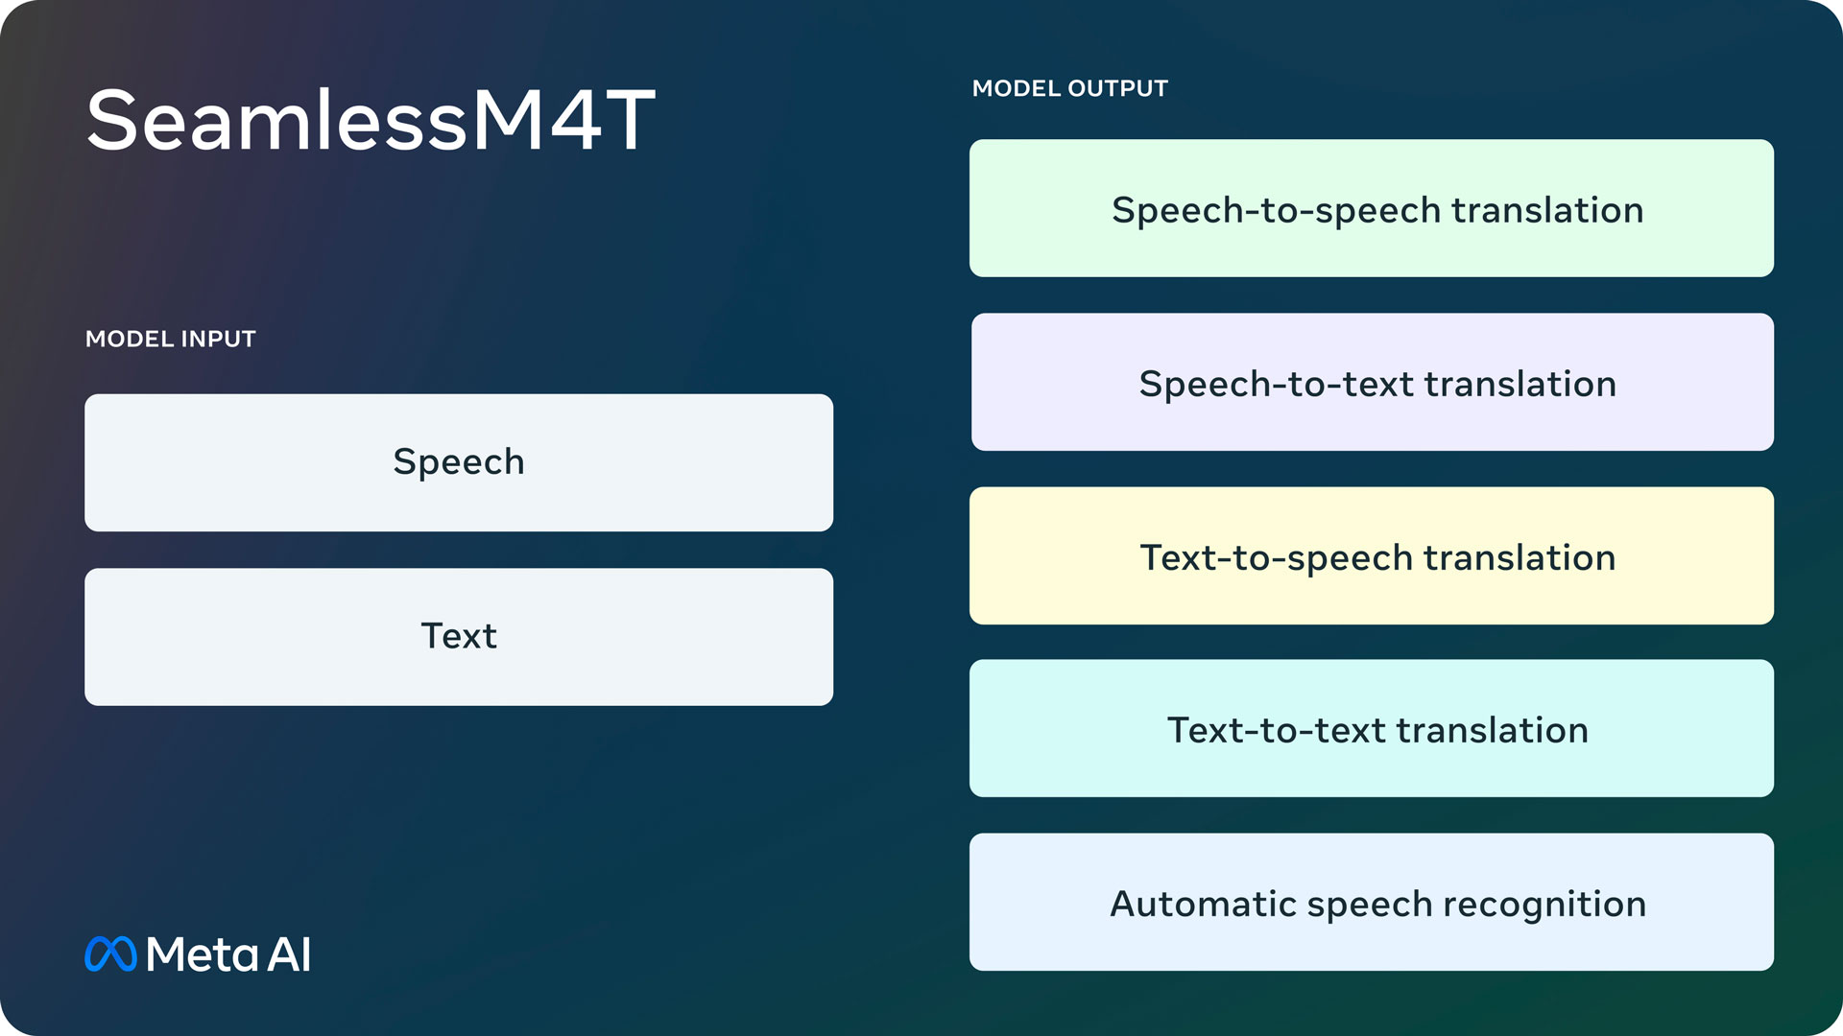
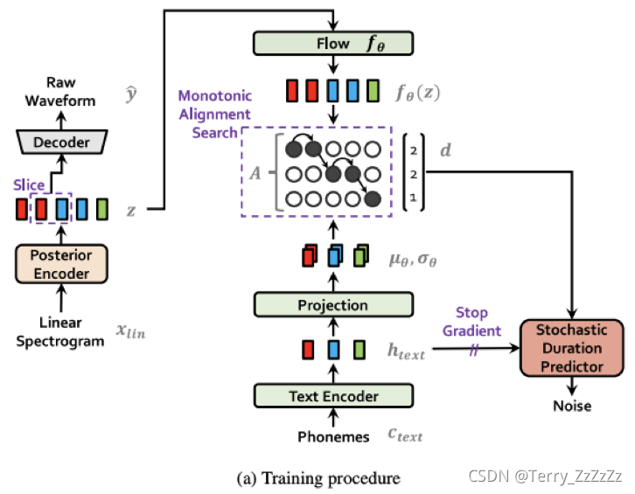


Model Architecture
Speech Input
Seamless-m4t
Translated Text
VITS
Translated Speech Output

Slide 6
Seamless-m4t

Slide 7
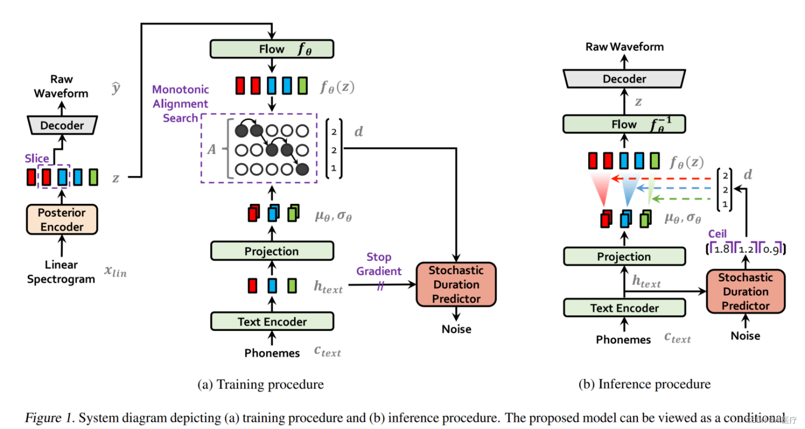
VITS
https://github.com/Plachtaa/VITS-fast-fine-tuning

Slide 8
Demo Time
https://5933f285c507e42035.gradio.live/

